Slide 1

Smart City Website
Luke, Aarond, Maxim, Alice Team 104

Slide 2
What was needed.
Centralised Web based system
Stores all information related to Brisbane.
Caters to three user types (student, businessmen and tourists).
Personalised tailored information to different user types.

Slide 3
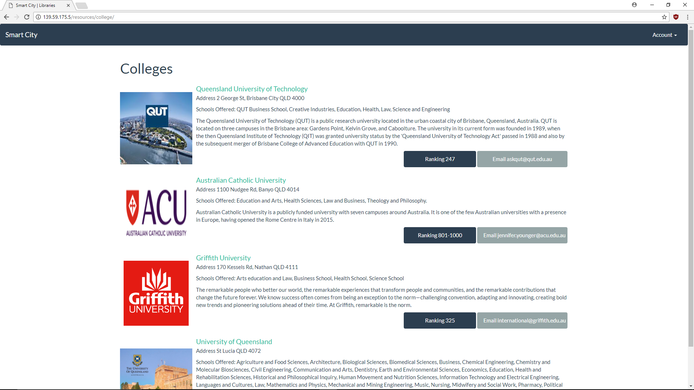
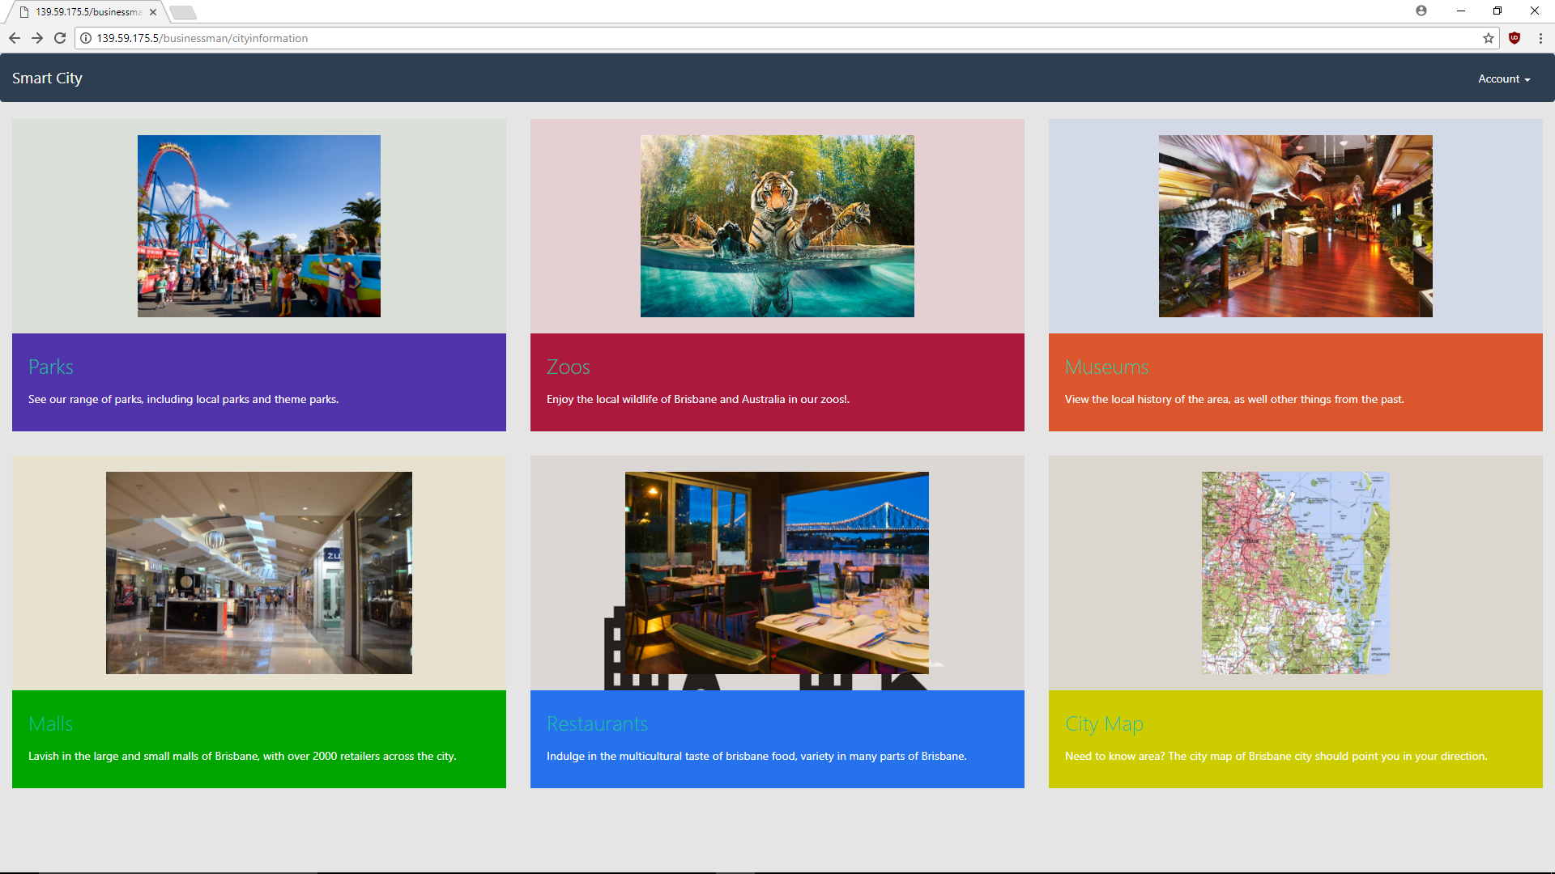
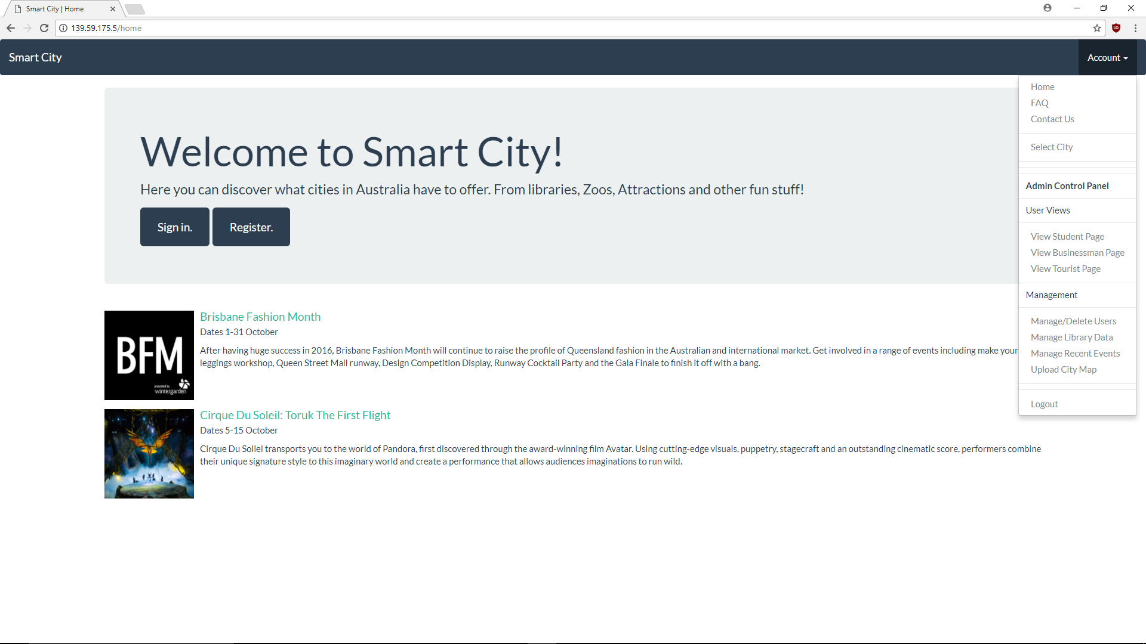
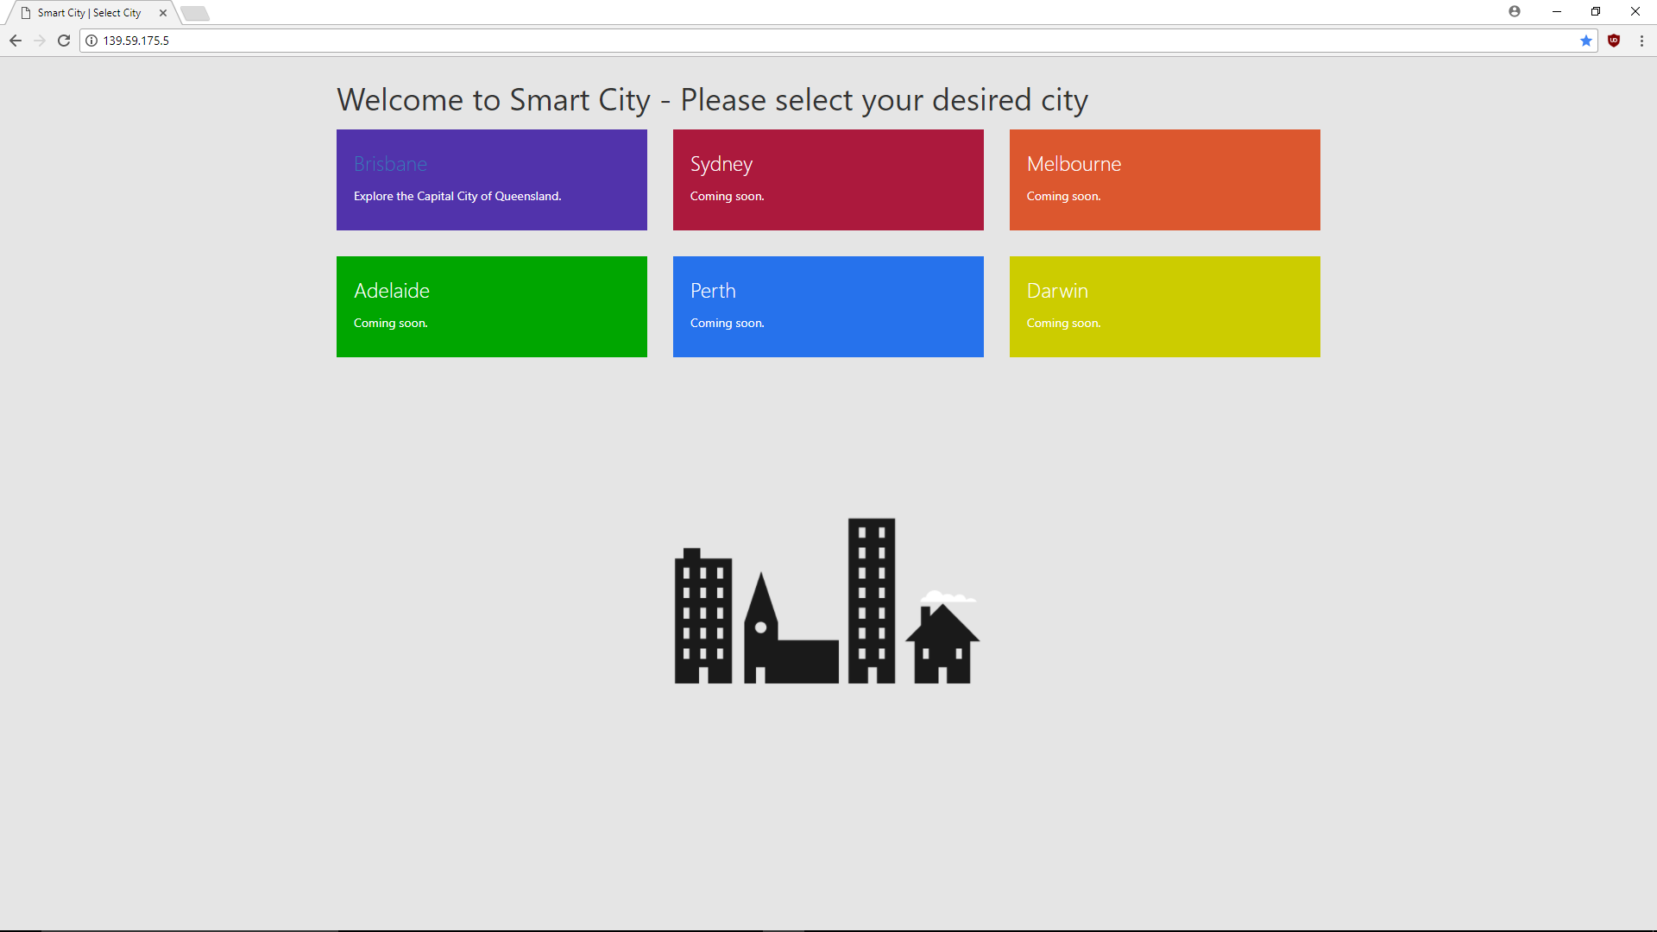
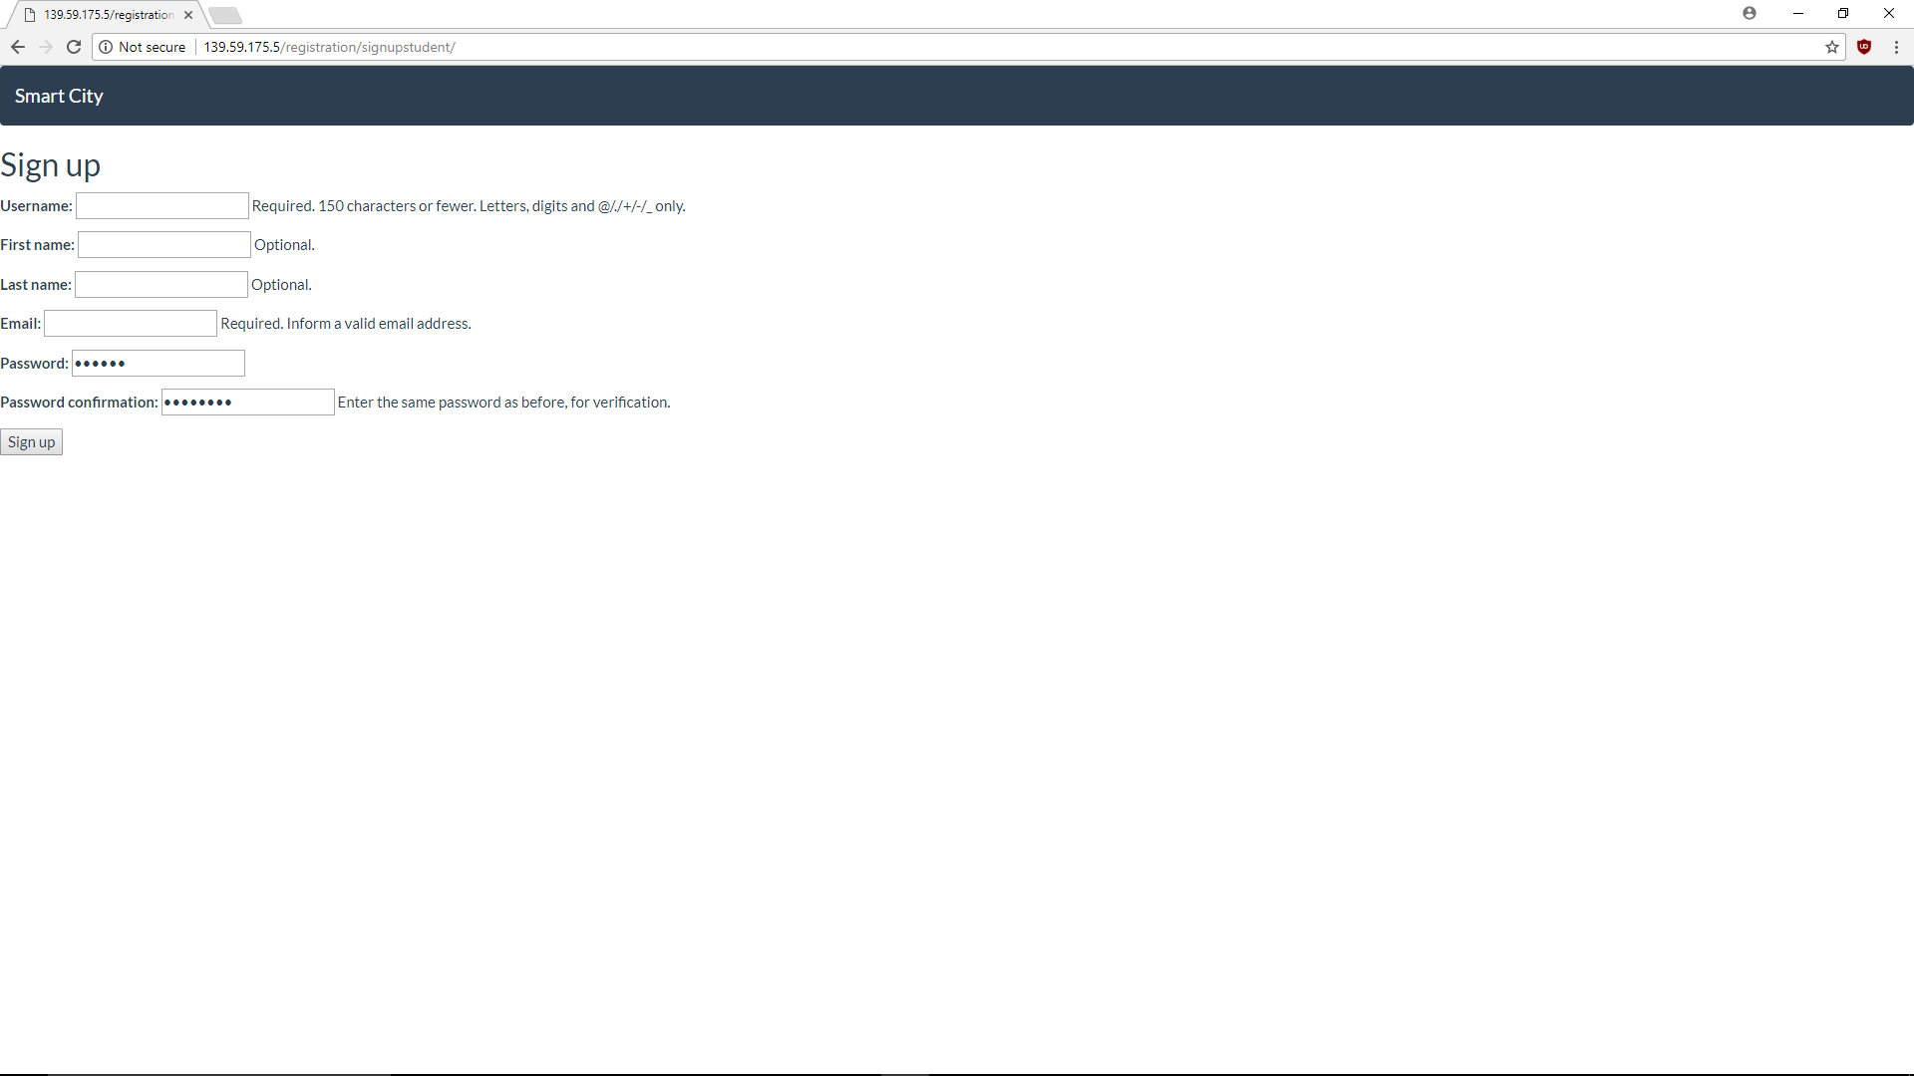
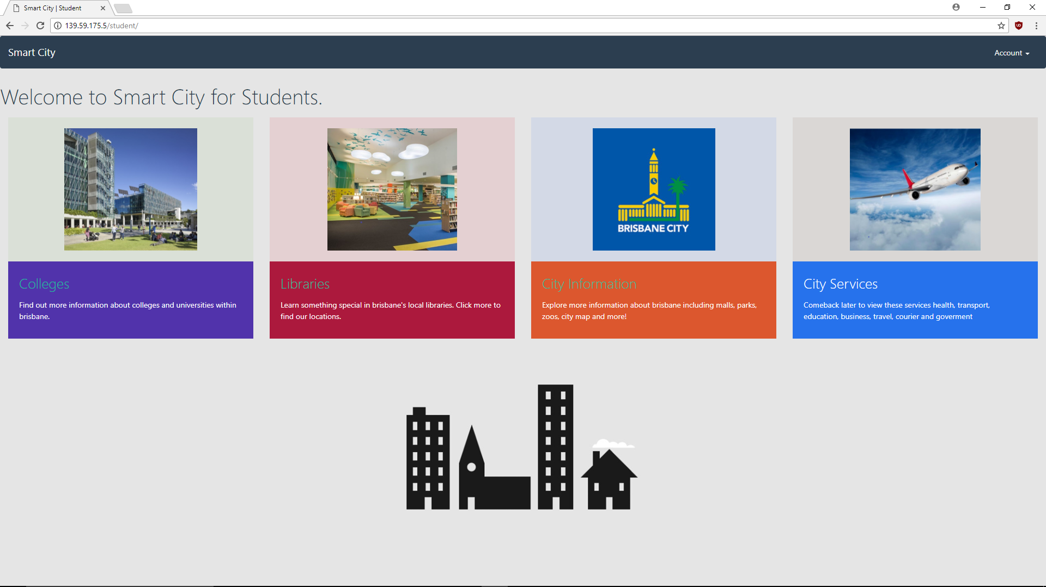
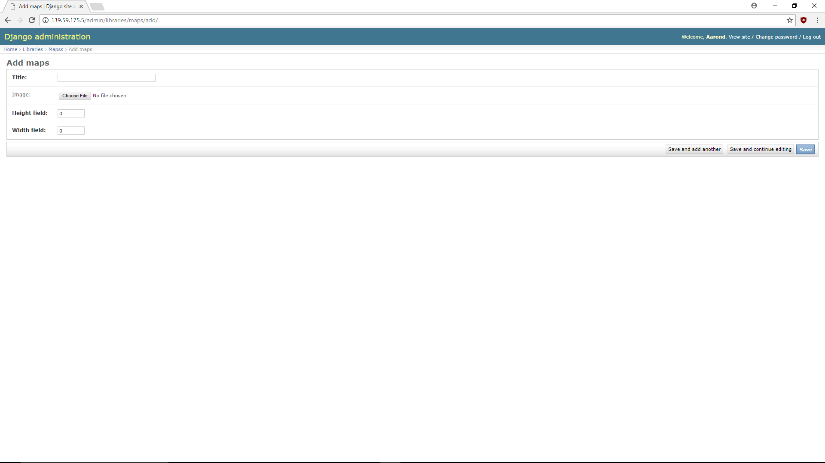

Slide 7
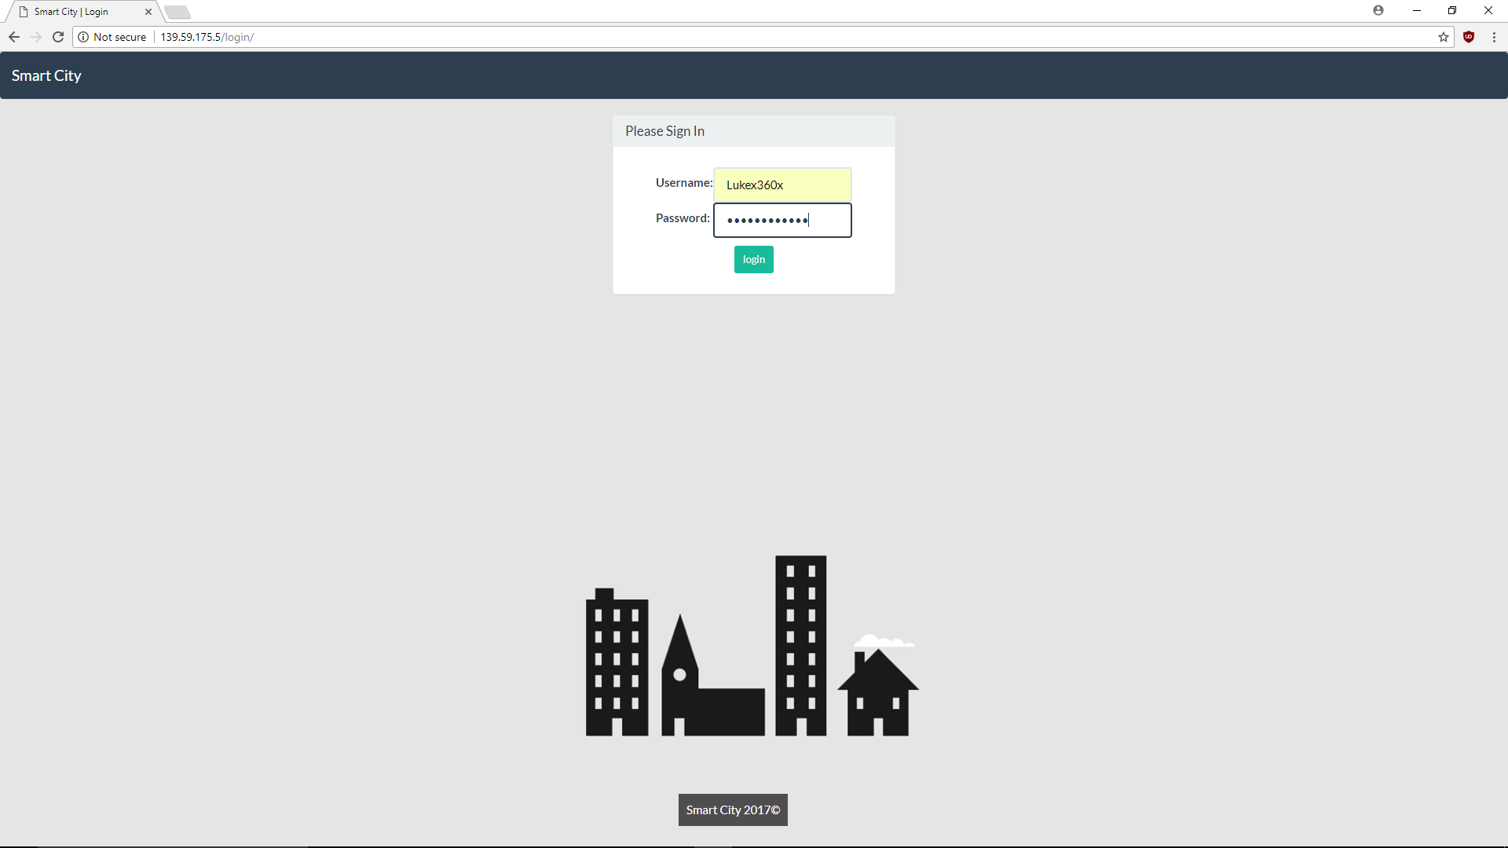

Slide 10



Highlight User Stories

Slide 11
Burndown Chart

Slide 12
Future Improvements
Having the event list linked up to an RSS feed.
Integrating a search bar, to allow the user to search the database quicker.
Having a link to google maps so the user can be sent directions.
Having the user be able to save locations that they might want to visit.
Having rating linked up from yelp.
Being able to sort items on a page alphabetically or by other traits.

Slide 13
Thank You

